Slide 1
B+ Trees

Slide 2
B+ Trees
What are B+ Trees used for
What is a B Tree
What is a B+ Tree
Searching
Insertion
Deletion

Slide 3
What are B+ Trees Used For?
When we store data in a table in a DBMS we want
Fast lookup by primary key
Just this – hashtable O(c)
Ability to add/remove records on the fly
Dynamic tree on disk
Sequential access to records (physically sorted by primary key on disk)
Tree structured keys (hierarchical index for searching)
Records all at leaves in sorted order

Slide 4
M-ary Search Tree- Revision
Maximum branching factor of M
Complete tree has depth = log_{M}N
Each internal node in a complete tree has M - 1 keys
Binary search tree is a B Tree where M is 2

Slide 5
B Trees
B-Trees are specialized M-ary search trees
Each node has many keys
subtree between two keys x and y contains values v such that x < v < y
binary search within a node to find correct subtree
Each node takes one full {page, block, line} of memory (disk)
3
7
12
21
x<3
3<x<7
7<x<12
12<x<21
21<x

Slide 6
B-Tree Properties
Properties
maximum branching factor of M
the root has between 2 and M children or at most M-1 keys
All other nodes have between ⎡M/2⎤ and M records
Keys+data
Result
tree is O(log M) deep
all operations run in O(log M) time
operations pull in about M items at a time
Notes:
All the other internal nodes (non-leaves) will have between M/2 and M children.
The funky symbol is ceiling, the next higher integer above the value.
The result of this is that the tree is “pretty” full. Not every node has M children but they’ve all at least got M/2 (a good number).
Internal nodes contain only search keys.
A search key is a value which is solely for comparison; there’s no data attached to it.
The node will have one fewer search key than it has children (subtrees) so that we can search down to each child.
The smallest datam between two search keys is equal to the lesser search key.
This is how we find the search keys to use.

Slide 7
What is a B+ Tree?
A variation of B trees in which
internal nodes contain only search keys (no data)
Leaf nodes contain pointers to data records
Data records are in sorted order by the search key
All leaves are at the same depth
Notes:
The properties of B-Trees (and the trees themselves) are a bit more complex than previous structures we’ve looked at.
Here’s a big, gnarly list; we’ll go one step at a time.
The maximum branching factor, as we said, is M (tunable for a given tree).
The root has between 2 and M children or at most L keys.
(L is another parameter)
These restrictions will be different for the root than for other nodes.

Slide 8
Definition of a B+Tree
A B+ tree is a balanced tree in which every path from the root of the tree to a leaf is of the same length, and each non-leaf node of the tree has between [M/2] and [M] children, where n is fixed for a particular tree.

Slide 9
B+ Tree Nodes
Internal node
Pointer (Key, NodePointer)*M-1 in each node
First i keys are currently in use
k₀
k₁
…
k_{i-1}
__
…
__
0
1
i-1
M - 2
Leaf
(Key, DataPointer)* L in each node
first j Keys currently in use
k₀
k₁
…
k_{j-1}
__
__
…
…
__
__
0
1
L-1
Data for k₀
Data for k₂
Data for k_{j-1}
Notes:
FIX M-I to M-I-1!!
Alright, before we look at any examples, let’s look at what the node structure looks like.
Internal nodes are arrays of pointers to children interspersed with search keys.
Why must they be arrays rather than linked lists?
Because we want contiguous memory!
If the node has just I+1 children, it has I search keys, and M-I empty entries.
A leaf looks similar (I’ll use green for leaves), and has similar properties.
Why are these different?
Because internal nodes need subtrees-1 keys.

Slide 10
Example: B+ Tree with M = 4. Often, leaf nodes linked together
10
40
3
15
20
30
50
1
2
10
11
12
20
25
26
40
42
3
5
6
9
15
17
30
32
33
36
50
60
70
Notes:
This is just an example B-tree. Notice that it has 24 entries with a depth of only 2.
A BST would be 4 deep.
Notice also that the leaves are at the same level in the tree. I’ll use integers as both key and data, but we all know that that could as well be different data at the bottom, right?

Slide 11

Advantages of B+ tree usage for databases
keeps keys in sorted order for sequential traversing
uses a hierarchical index to minimize the number of disk reads
uses partially full blocks to speed insertions and deletions
keeps the index balanced with a recursive algorithm
In addition, a B+ tree minimizes waste by making sure the interior nodes are at least half full. A B+ tree can handle an arbitrary number of insertions and deletions.

Slide 12
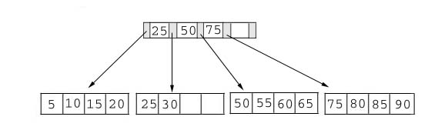
Searching
Just compare the key value with the data in the tree, then return the result.
For example: find the value 45, and 15 in below tree.
Result:
1. For the value of 45, not found.
2. For the value of 15, return the position where the pointer located.

Slide 13
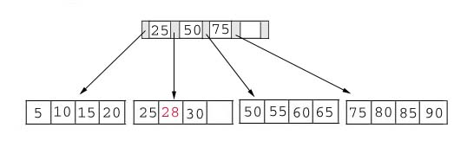
Insertion
inserting a value into a B+ tree may imbalance the tree, so rearrange the tree if needed.
Example #1: insert 28 into the below tree.
25 28 30
Fits inside the leaf

Slide 14
Insertion
Example #2: insert 70 into below tree

Slide 15
Insertion
Process: split the leaf and propagate middle key up the tree
50 55 60 65 70
Does not fit inside the leaf
50 55
60 65 70

Slide 16
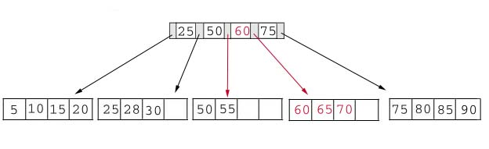
Insertion
Result: choose the middle key 60 and place it in the index page between 50 and 75.

Slide 17

Insertion
The insert algorithm for B+ Tree
Leaf Node Full | Index Node Full | Action
NO | NO | Place the record in sorted position in the appropriate leaf page
YES | NO | Split the leaf node Place Middle Key in the index node in sorted order. Left leaf node contains records with keys below the middle key. Right leaf node contains records with keys equal to or greater than the middle key.
YES | YES | Split the leaf node. Records with keys < middle key go to the left leaf node. Records with keys >= middle key go to the right leaf node. Split the index node. Keys < middle key go to the left index node. Keys > middle key go to the right index node. The middle key goes to the next (higher level) index node. IF the next level index node is full, continue splitting the index nodes.

Slide 18
Insertion
Example: add a key value 95 to the below tree.
75 80 85 90 95
Leaf node full, split the leaf.
75 80
85 90 95
25 50 60 75 85
Notes:
Add 95 to 75, 80, 85, 90; node full. Split into: 75, 80 and 85, 90 95. Propagate middle value (85) to parent.
Parent is full with 25, 50, 60, 75. Split into 25, 50 and 60, 75, 85. Propagate middle value (60) up the tree.

Slide 19
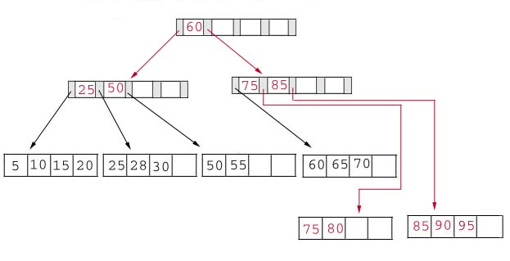

Insertion
Result: Again, put the middle key 60 to the index page and rearrange the tree.
Notes:
B+ Trees grow UP from the bottom

Slide 20
Deletion
Same as insertion, the tree must be rebuilt if the deletion result violate the rule of B+ tree.
Example #1: delete 70 from the tree
OK. Node >=50% full
60 65

Slide 21
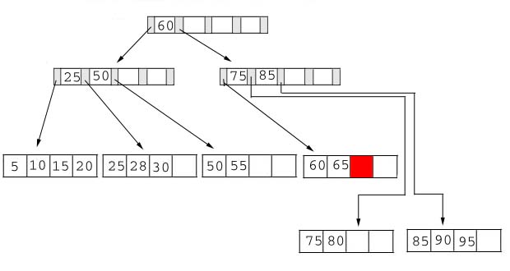
Deletion
Result:
Notes:
Locate it in the leaf node. Delete it. Node is still >= 50% full, all done.

Slide 22

Deletion
Example #2: delete 25 from below tree, but 25 appears in the index page.
But…
28 30
This is OK.
Notes:
Locate 25 in leaf. Delete it. Node still >= 50% full so okay.
BUT, 25 was used in index node….
Propagate smallest value in leaf node (28) up the tree to replace it.

Slide 23
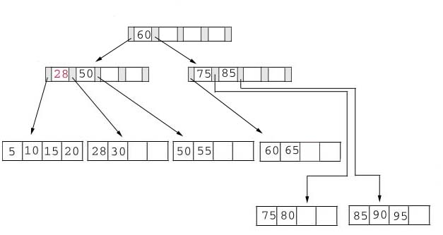
Deletion
Result: replace 28 in the index page.
Add 28

Slide 24

Deletion
Example #3: delete 60 from the below tree
65
Less than 50% full
50 55 65
Notes:
Locate 60 in leaf node Delete it. Leaf now < 50% full.
Neighbor at most 50% full, so merge with neighbor to the right. Guaranteed to fit.

Slide 25
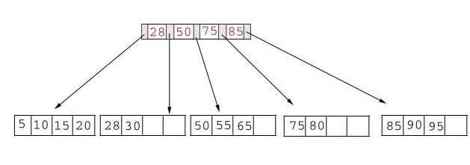

Deletion
Result: delete 60 from the index page and combine the rest of index pages.

Slide 26
Deletion
Delete algorithm for B+ trees
Data Page Below Fill Factor | Index Page Below Fill Factor | Action
NO | NO | Delete the record from the leaf page. Arrange keys in ascending order to fill void. If the key of the deleted record appears in the index page, use the next key to replace it.
YES | NO | Combine the leaf page and its sibling. Change the index page to reflect the change.
YES | YES | Combine the leaf page and its sibling. Adjust the index page to reflect the change. Combine the index page with its sibling. Continue combining index pages until you reach a page with the correct fill factor or you reach the root page.

Slide 27
Conclusion
It is “easy” to maintain its balance
Insert/Deletion complexity O(log M )
The searching time is shorter than most of other types of trees because branching factor is high

